Slide 1

Do American films rate differently from the rest of the world's?
A comparison of Letterboxd average ratings for American and non-American films, and whether the gap changes by genre.
LINH NGUYEN

Slide 2

Who this is for:
Film and media scholars studying how American cinema is received abroad and at home
Letterboxd users and critics who use ratings to find films
Film distributors and studios deciding how to position and market films
Stakeholders
Studios, distributors: Use the genre gaps to see where US films face tougher audiences (Sci-Fi, Fantasy, Horror, Action).
Film scholars / American Studies: Study how American cinema is judged by a cinephile audience, and where the gap is widest (franchise genres) or reversed (Documentary).
Letterboxd and recommender systems: Check whether ranking by average rating favors non-US films.
Filmmakers and festivals: Understand how origin shapes reception.
Viewers: Read ratings with the genre and origin context in mind.

Slide 3

The data: one row per film
941,597
films in the dataset
90,999
have an average rating (5-star scale)
87,286
usable after cleaning
Features per film: origin, release year, runtime, and 19 genres.
Origin groups: US only (35%), US co-production (11%), non-US (54%). "American" means US production, not an American story.
Cleaning: runtimes clipped at 400 minutes (max was 51,420) and log-transformed, years limited to 1900 to 2025, missing runtimes imputed with the median.

Slide 4
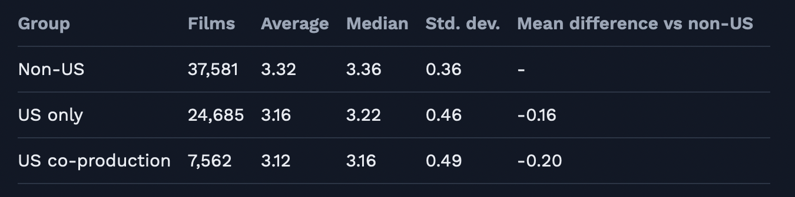


Group comparison: descriptive statistics
Pattern
The mean difference grows from US only (-0.16) to co-productions (-0.20), and medians follow the same order. The standard deviation rises with US involvement. US only vs non-US gives a Cohen's d of about 0.4, a small-to-moderate effect size.
What it means
Co-productions are not "in between": they rate lowest. They lean toward Thriller, Action, and Adventure, so a mix of commercial genres may be part of why. A larger standard deviation means US films have more very high and very low ratings.

Slide 5
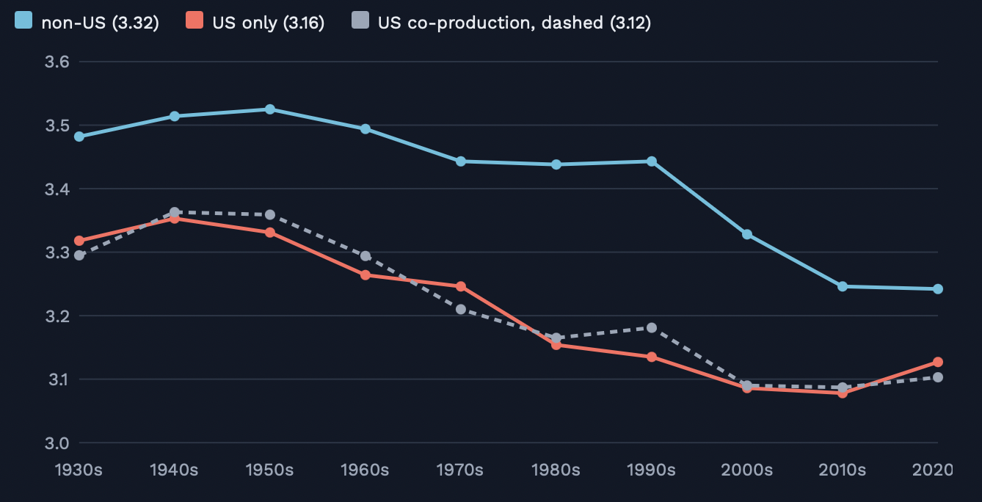


Pattern 1: non-US films rate higher in every era
Pattern
The teal line is above the others in every decade, but the gap changes size: from about 0.12 to 0.31 stars depending on the decade.
What it means
The direction never changes, but the size does (next slide). All lines fall over time, likely because old films still rated are survivors while recent decades include many obscure releases.

Slide 6
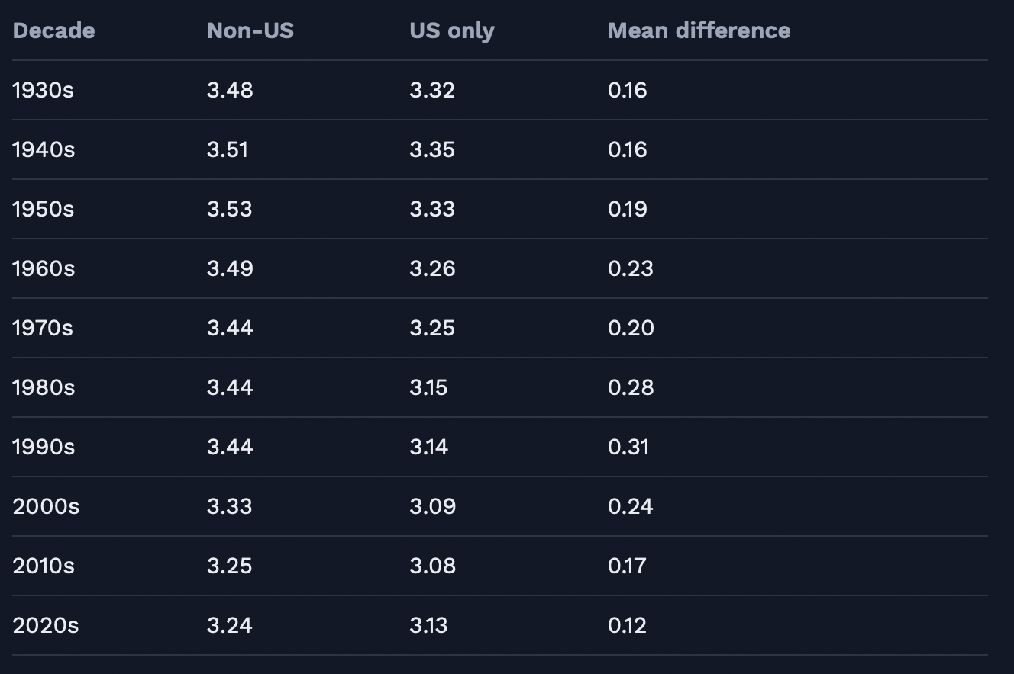
Mean rating by decade and origin
Pattern
The gap grew from about 0.16 in the 1930s and 1940s to a peak of 0.28 to 0.31 in the 1980s and 1990s, then narrowed to 0.17 in the 2010s and 0.12 in the 2020s.
What it means
I earlier described the gap as steady, and this table corrects that. Possible reasons, untested: Letterboxd's recent growth brings casual raters and more obscure non-US films. A year-by-origin interaction in the model would test it.

Slide 7
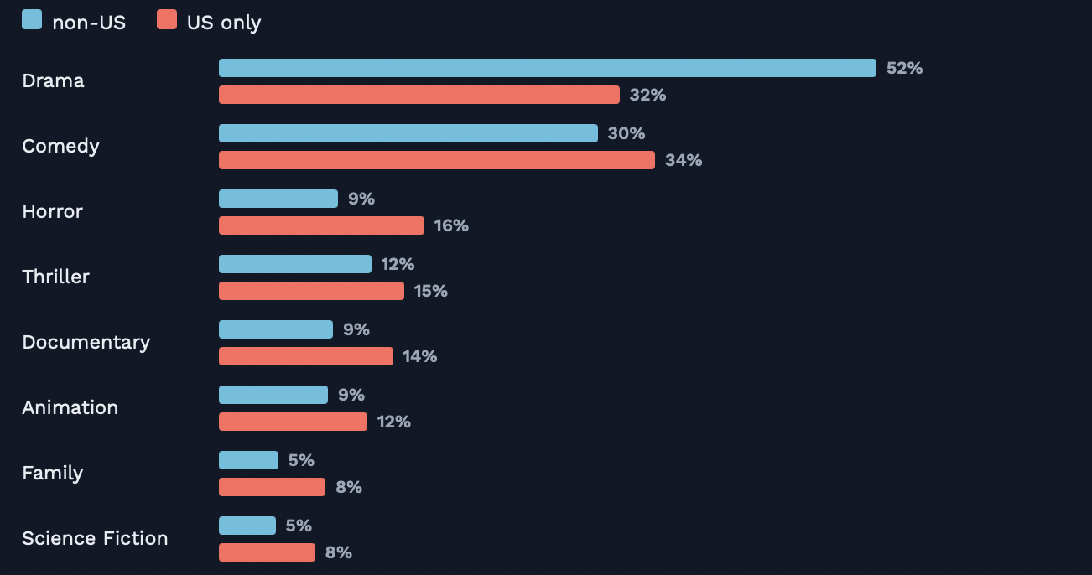
Pattern 2: US films spread across more genres
Pattern
Drama is 52% of non-US films vs 32% of US-only films. US films have more comedy, horror, family, and science fiction.
What it means
US films cluster in genres with larger gaps, so genre could have explained the whole difference. We tested that, and it did not.

Slide 8
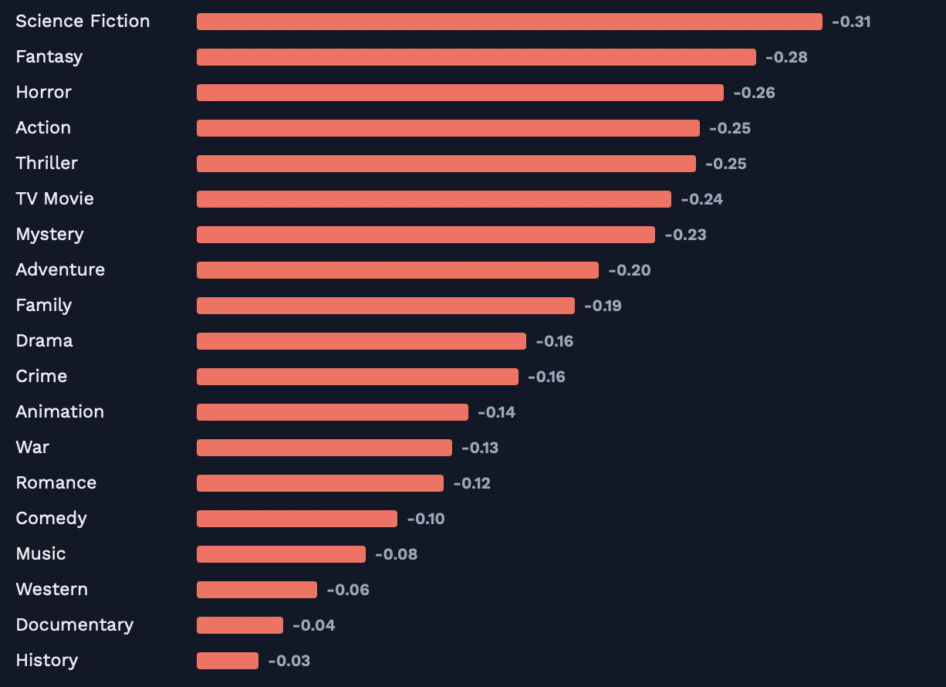
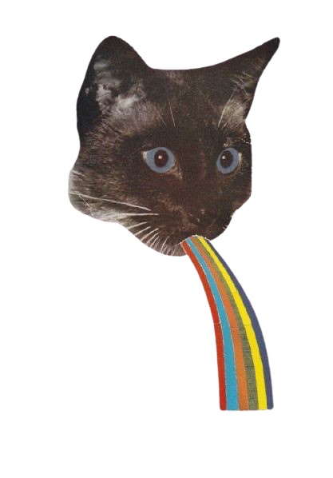
Pattern 3: the gap shows up in all 19 genres
Pattern
Every bar is negative. The gap is largest in Science Fiction (-0.31), Fantasy, Horror, and Action, and smallest in History and Documentary (about -0.03 to -0.04).
What it means
This is not a one-genre story. It is strongest in studio-style, franchise-friendly genres.

Slide 9
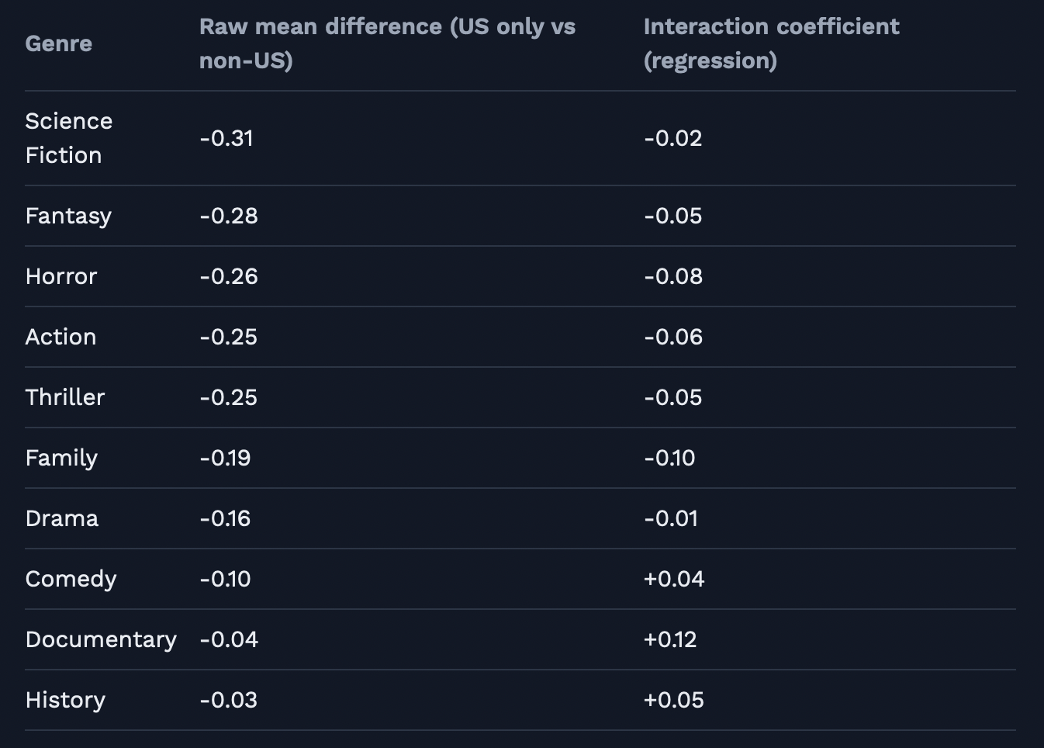
Genre results: raw mean difference vs interaction coefficient
Pattern
Raw mean differences range tenfold, from -0.31 to -0.03. The interaction coefficients are smaller, from -0.10 to +0.12.
What it means
Family is the only genre whose interaction coefficient stays large. Science Fiction's raw difference shrinks to -0.02 once overlapping genres, year, and runtime are controlled for (confounding), and Documentary's coefficient turns positive.

Slide 10
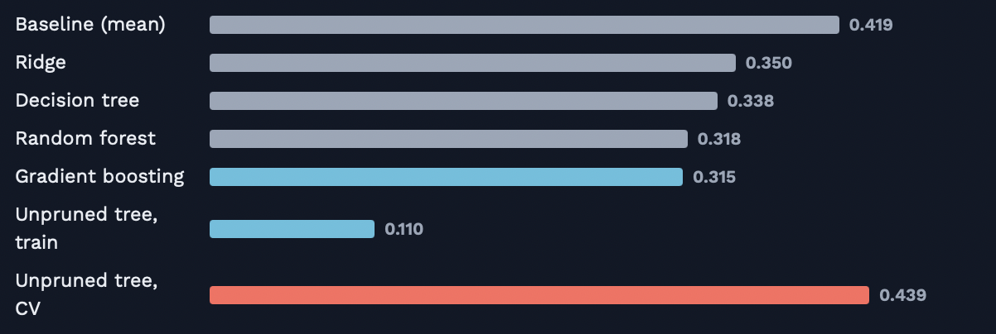
Model comparison: all beat the baseline, tree models beat the linear model
Pattern
Every model beats the 0.419 baseline. Tree-based models have about 0.03 lower RMSE than the linear model (Ridge, 0.350). The unpruned tree had a training RMSE of 0.110 but a cross-validated RMSE of 0.439.
What it means
Ratings depend on features in nonlinear ways that an additive linear model misses. The unpruned tree overfit the training set, which is why we rely on validation scores from unseen data.

Slide 11
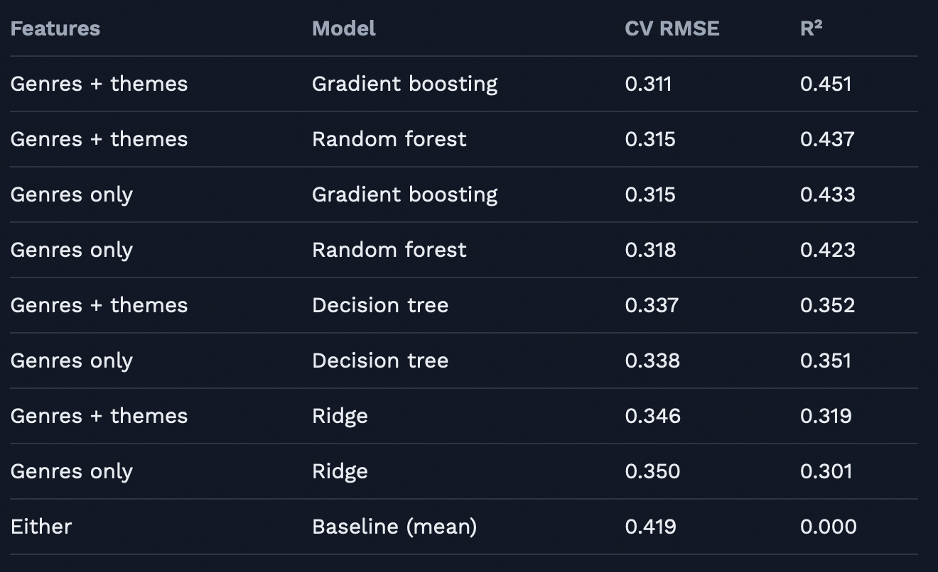
All model results
Pattern
The ranking is the same with or without themes. Themes lower CV RMSE by 0.001 to 0.004 and raise R² by up to 0.018. Cross-validated and test RMSE both equal 0.315.
What it means
Model choice changes RMSE by about 0.03, while adding themes changes it by about 0.004. I kept genre-only for simplicity and full coverage, but boosting with themes had the best CV RMSE (0.311).

Slide 12

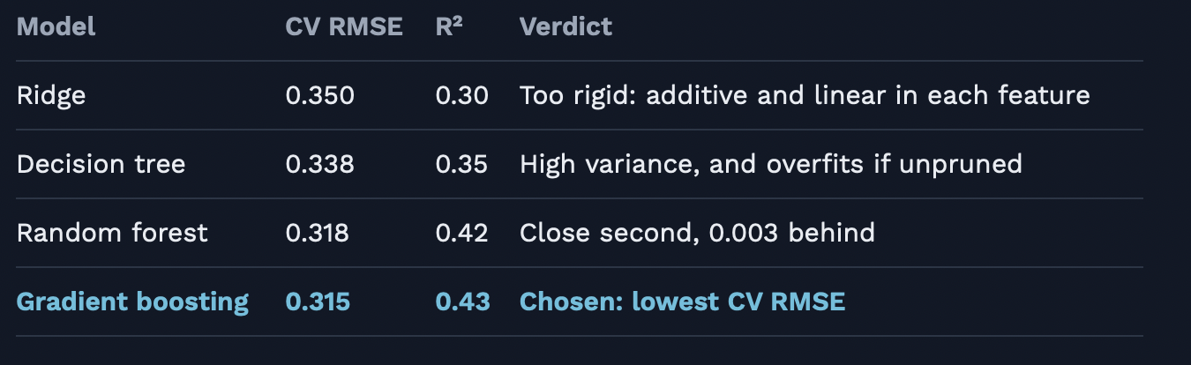

Why gradient boosting won
Boosting fits many small trees in sequence, each correcting the residuals of the previous ones.
Hyperparameter tuning did not change the CV RMSE (0.315), so the defaults were already near the best for these features.

Slide 13
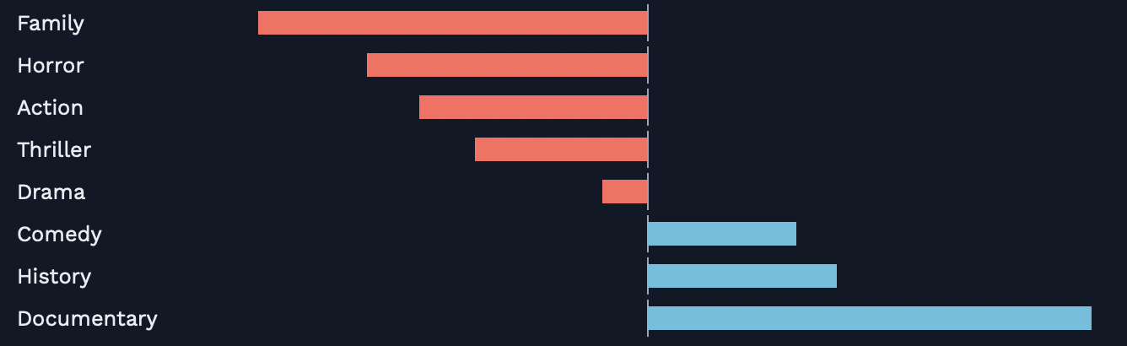

The US effect: multiple regression with controls
Pattern
The coefficient is the same before and after controls (-0.16). It varies by genre (interaction): more negative for Family, Horror, and Action, and positive for Documentary (+0.12).
-0.16 stars
US-involved vs non-US, controlling for genre, year, and runtime. 95% CI: -0.165 to -0.154.
What it means
Genre, year, and runtime do not confound it. The interactions are statistically significant but small, reducing residual variance by about 1%. With 70,000 films, effect size matters more than the p-value

Slide 14
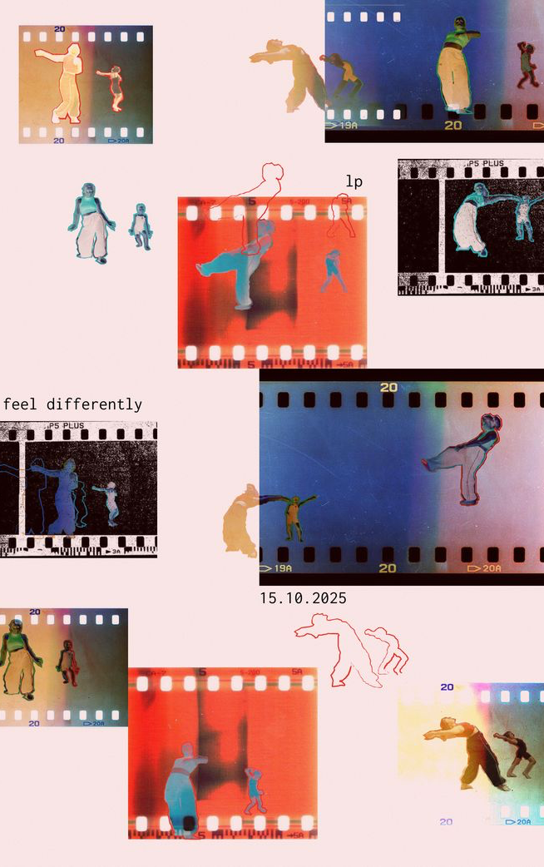
What it might mean for American Studies
Industry: the widest gaps are in genres tied to Hollywood franchises and mass-market entertainment, which cinephile raters may judge harder.
Horror: American horror often works through social fears, as in Black Horror, but one average blends slashers with pointed films. Split by subgenre next.
Documentary: the reversal may reflect a tradition of social inquiry.
Filtering: non-US films reach Letterboxd through festivals and distributors, while US films arrive unfiltered.

Slide 15



Limits and what to do better next time
Limits
No rating-count variable, so some average ratings are noisy. Letterboxd users are a self-selected sample (selection bias). The result shows association, not cause. "American" comes from production country. Themes are missing for most films.
Next time
Add rating counts and filter or weight by them. Compare countries one by one, not as "non-US". Add budget, cast, and production details. Analyze film descriptions for social themes. Repeat cross-validation to test whether boosting truly beats the random forest. Use a time-based split: train on older films, test on the newest.

